Slide 1
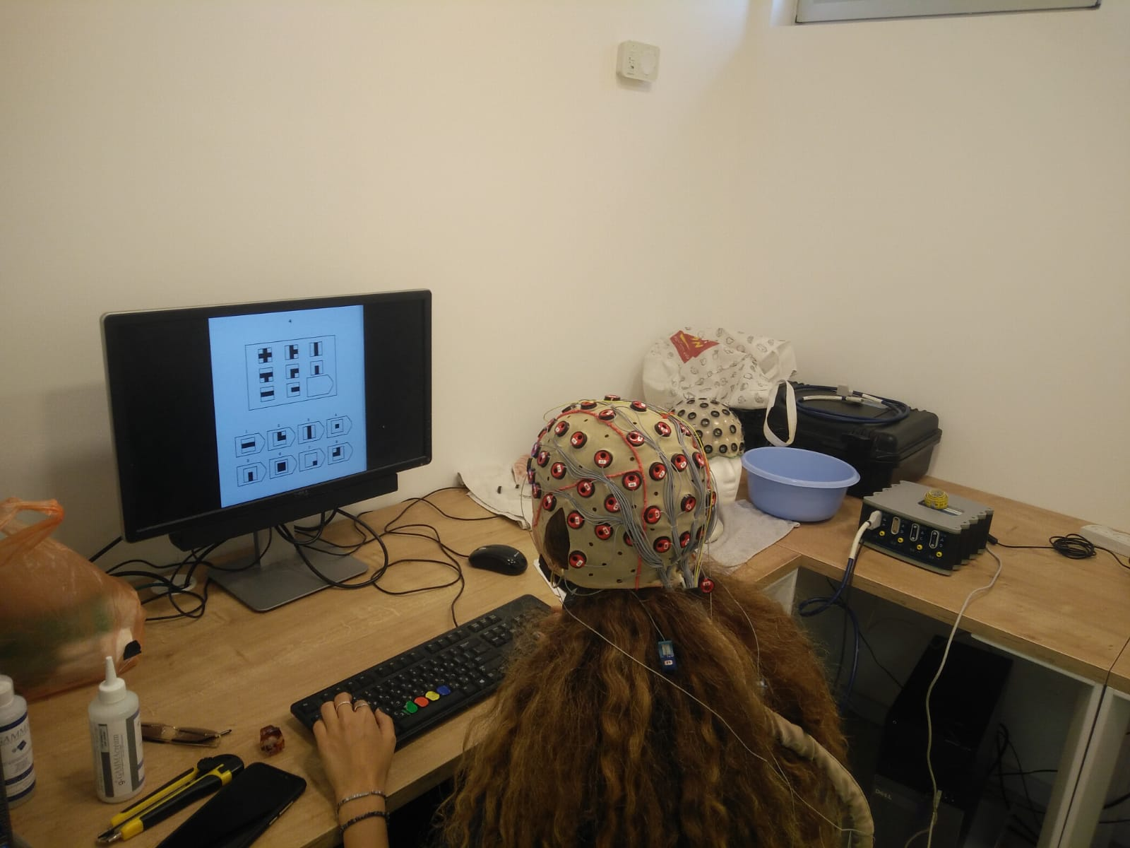
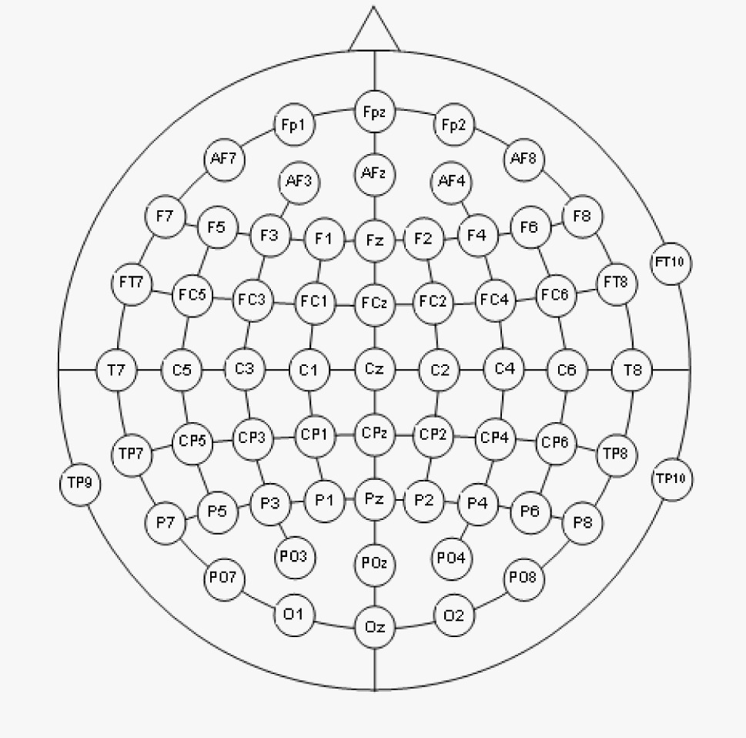
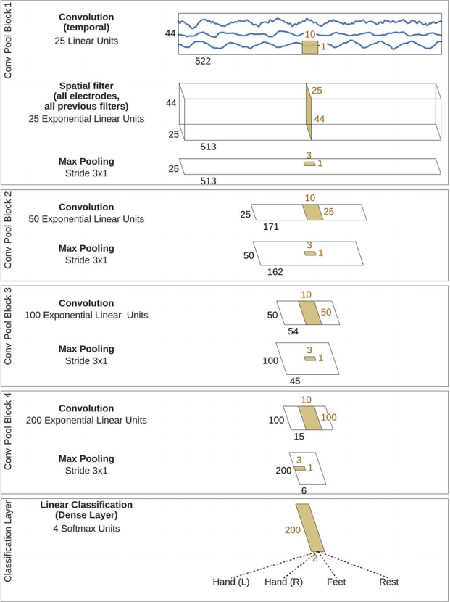
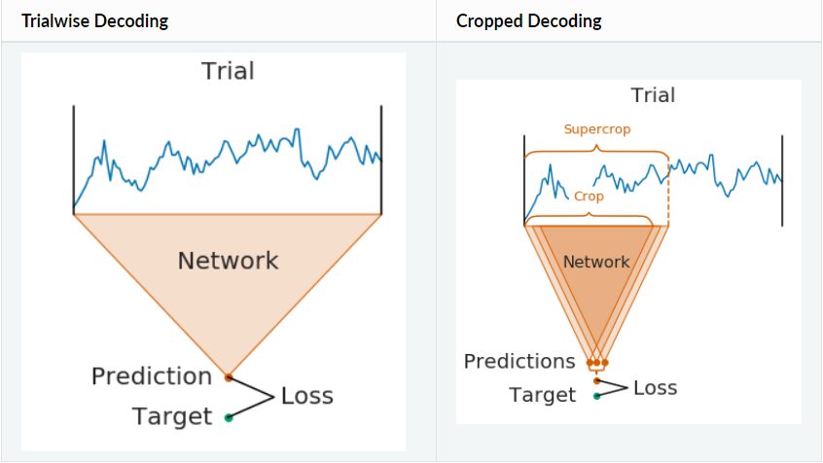
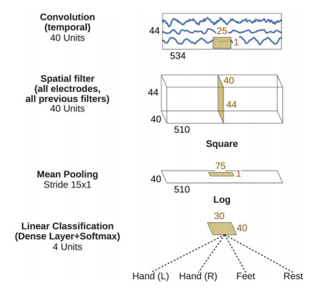
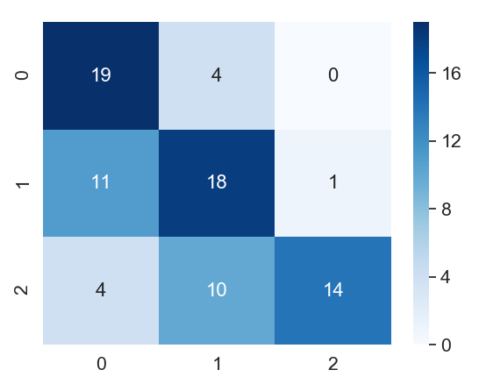


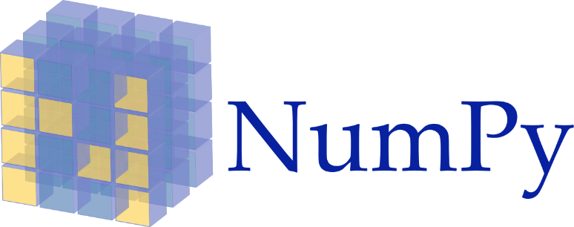
Faculty of Natural Sciences
The Department of Computer Science
EEG-based Cognitive Workload Estimation using Deep ConvNets
Shaked Aharon
Advisor: Dr. Oren Shriki
Motivation
Cognitive workload refers to the relative load on our limited cognitive resources.
High workload affects decision making and may lead to fatal errors even in routine procedures.
Monitoring workload has many applications from e-learning to monitoring drivers and pilots.
Raven’s Test
Subjects were requested to answer the Raven’s Matrices test.
36 Questions in increasing level of difficulty.
EEG
EEG is a monitoring method to record electrical activity of the brain.
EEG signal is a dynamic time series signal across multiple electrodes on the scalp.
Subjects were monitored while taking an intelligence test (the Raven’s matrices test).
Convolutional Neural Networks (CNN)
CNN can exploit the hierarchical structure found in natural signals.
Recent publications [1] showed that advancements in deep learning can help decoding motor imagery EEG signal, and proposed follow-up research on different EEG decoding tasks.
We evaluated:
Different architectures:
shallow / deep CNN.
Different trial lengths.
Single subject / cross subjects.
Different training strategies:
trial-wise / crops.
Preparing The Dataset
Questions were divided to 3 levels of difficulty.
EEG signal was bandpass filtered, cut into trials and labeled by question difficulty.
Minimal preprocessing was made, to determine whether the network can learn to extract features from raw EEG signal.
Bibliography
Schirrmeister RT, Springenberg JT, Fiederer LD, Glasstetter M, Eggensperger K, Tangermann M, Hutter F, Burgard W, Ball T. Deep learning with convolutional neural networks for EEG decoding and visualization. Human brain mapping. 2017 Nov;38(11):5391-420.
Friedman N, Fekete T, Gal K, Shriki O. EEG-based Prediction of Cognitive Load in Intelligence Tests. Front. Hum. Neurosci. 13:191.
Preliminary Results
Preliminary results demonstrate the applicability of using CNN for quantifying cognitive workload, with 37% misclass.
Technologies

